Slide 1
Java Code Review with CheckStyle

Slide 2
Tools to automate code review & analysis
http://en.wikipedia.org/wiki/List_of_tools_for_static_code_analysis
JAVA
CheckStyle (http://checkstyle.sourceforge.net/)

Slide 3
CheckStyle tool
What is Checkstyle?
Checkstyle is an open-source development tool to help programmers write Java code that adheres to a coding standard
It automates the process of checking Java code to verify code following standard or not. This makes it ideal for projects that want to enforce a coding standard.
Official web site for releases and usage guide-line document http://checkstyle.sourceforge.net/

Slide 4
How Checkstyle works
As in the above figure:
Checkstyle is add-ins component to IDE/Build tool
Coding standard is user pre-defined, and embedded in each XML file
Checkstyle will depend on XML file to parse code, then generate checking result to

Slide 5
How Checkstyle works
Checkstyle supports add-ins for various Java IDE and Build tools, such as:
Eclipse
NetBeans
IntelliJ
BlueJ
Borland JBuilder
Maven
Ant

Slide 6
Use CheckStyle with Eclipse
Sequential steps below help us to setup, define, and run checkstyle in Eclipse
Setup add-in to Eclipse:
There are two ways to plug the add-in to Eclipse:
Manually download library from the official site, and copy to the Eclipse plug-ins folder
Make Eclipse to automatically download and update the library

Slide 7
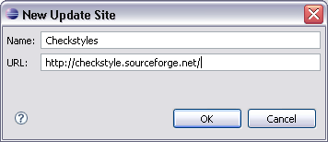
Use CheckStyle with Eclipse
Open Eclipse
Go to Help→ Software updates → Find and install
Choose “Search for new features to install”, then click the “Next” button
Click the “New Remote Site” and input checkstyle website address, like
Click “OK” button, then wait for Eclipse to automatically update

Slide 8
Define a coding standard XML file for your own
We can create and edit your checkstyle by manually or use editor tool from Eclipse after Eclipse update checkstyle successfully
The steps here is example to use the editor
From Eclipse, go to Window->Preference, then click CheckStyle node on the left tree. You will see a list of defined CheckStyle
Click “New”, choose “Internal Configuration” and name to your checkstyle
The editor appeared, as below, and you can walk though sections on the left menu that checkstyle can support to check code

Slide 9
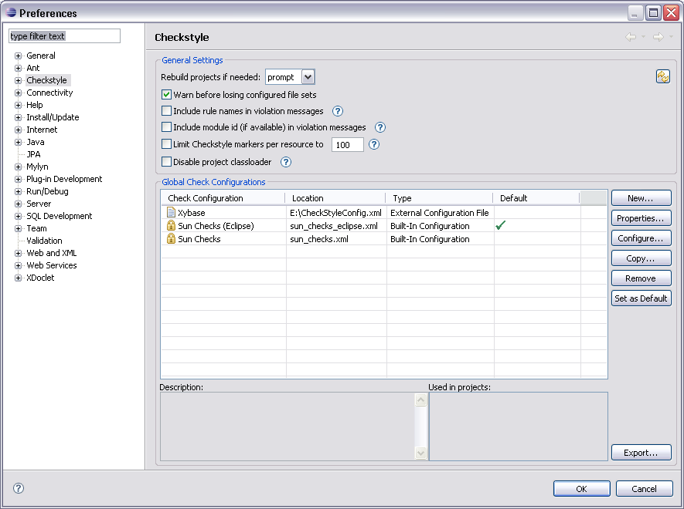
Define a coding standard XML file for your own

Slide 10
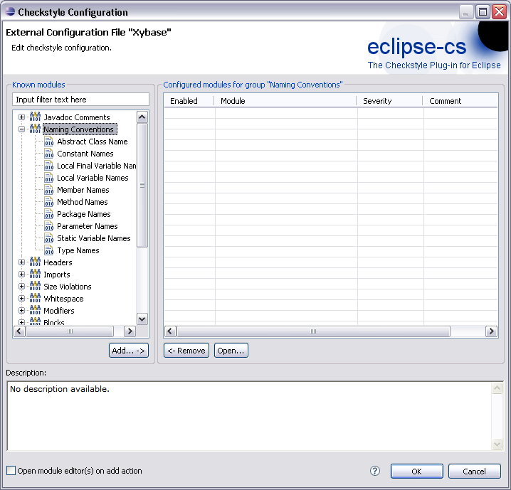
Define a coding standard XML file for your own

Slide 11
Active your CheckStyle
In the previous step, you already defined a checkstyle. In this section, it will show you the ways to active your checkstyle and apply the checkstyle into your project
Right click to your project icon, and choose “Properties” menu, a dialog below appears
Click the “Checkstyle” menu and choose your own
checkstyle from the available checkstyles list in combo-box
3. Click “OK” to finish

Slide 12
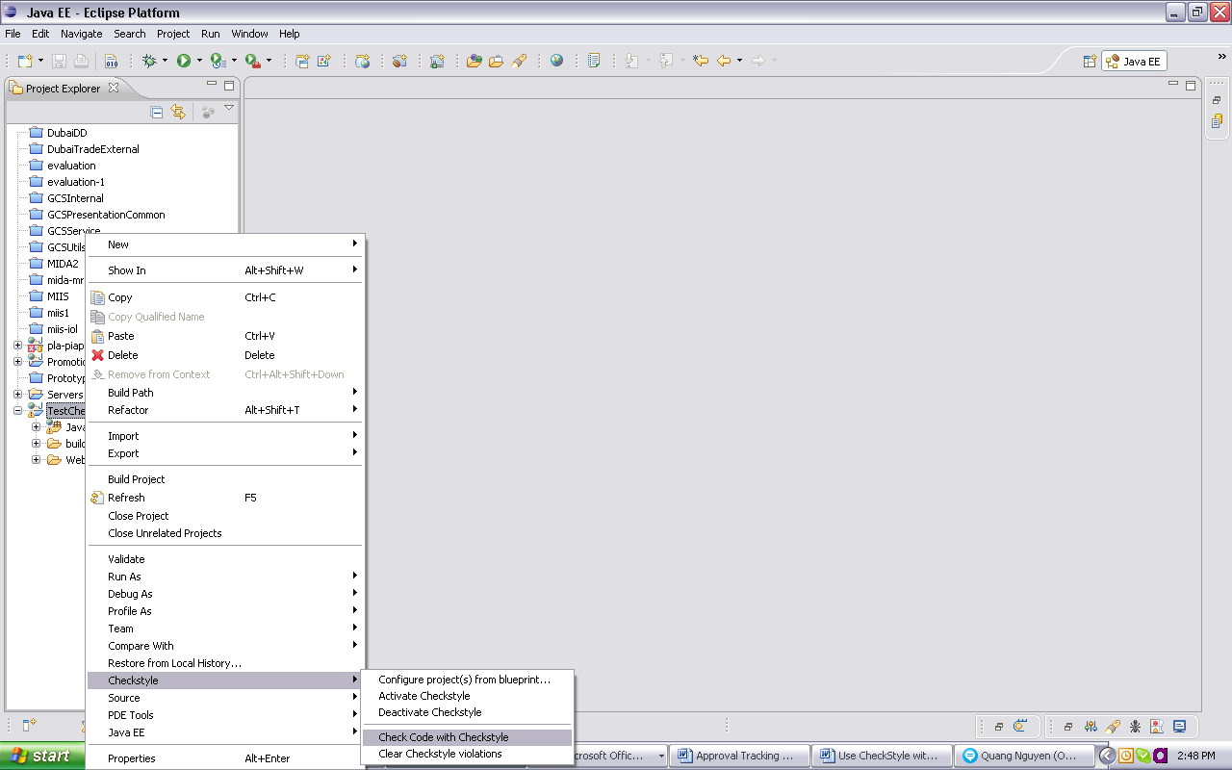
Active your CheckStyle
The screen below show us the bar we can execute checkstyle from Eclipse

Slide 13
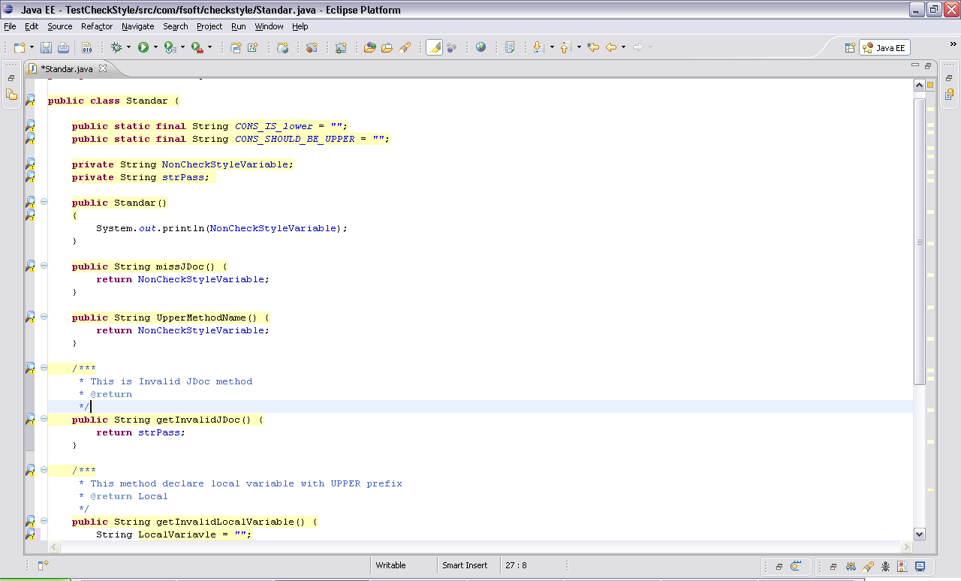
Active your CheckStyle
After click the button “Check code with CheckStyle” you will see checkstyle mark YELLOW NOTE icon to class files
Move your mouse to the YELLOW ICON, you will receive a warning message about cause of invalid grammar. Follow that to fix and your invalid code grammar

Slide 14
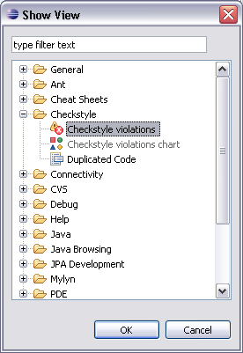
Active your CheckStyle
Checkstyle plugin supports us two reports:
- Chart report
- Statistic report
To use two functions with Eclipse, you can go to Window->Show View->Other to see these both report types as beside:

Slide 15
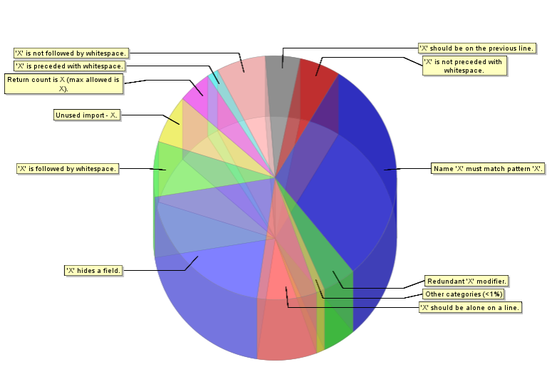
Active your CheckStyle
Click one of them, you will see a dialog appeared with two REPORT GENERATE buttons on the left menu. Then, click to the REPORT button to see report
Followings are results of two reports

Slide 16
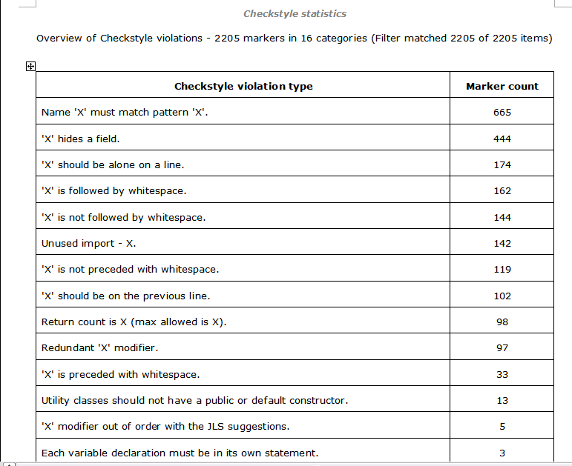
Active your CheckStyle

Slide 17


